Slide 1
ART: Automated Redox-Titration with Interdigitated Electrode Arrays for Energy Storage Materials
Zirui Wang
3rd year Ph.D. Student
Department of Materials Science and Engineering University of Illinois, Urbana-Champaign (UIUC)
Advisor: Prof. Joaquín Rodríguez-López
247th ECS Meeting, Montreal, Canada
May 20th, 2025

Slide 2
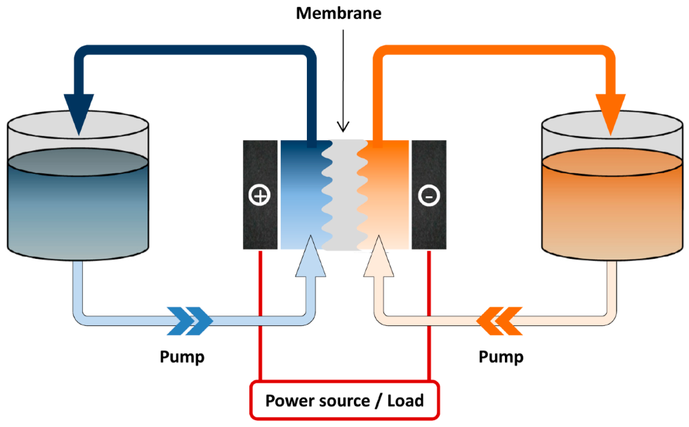
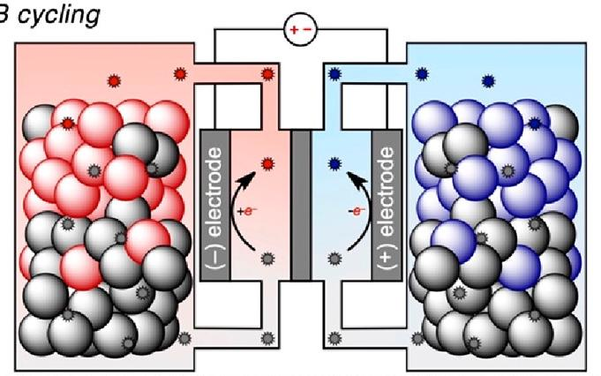
Redox Flow Batteries for Grid-Level Energy Storage
Redox flow battery (RFB)
Redox targeting flow battery (RTFB)
Membrane
Charge/discharge
(Cathode tank)
(Anode tank)
Source/Load
e⁻
A
B
e⁻
Cathode
Tank
Anode
Tank
A⁻
B⁺
membrane
Current
Pump
Pump
Source/load
Highly scalable, decoupled power and capacity
Limitation: Energy density is limited by the solubility of redox-active species
Stores energy in a solid material
Active species concentration up to 20 M
Redox mediators shuttle charges between the solid and electrode via a mediated electron transfer process known as redox targeting
Molecules 2015, 20 (11), 20499–20517
ACS Energy Lett. 2022, 7 (10), 3337-3344

Slide 3
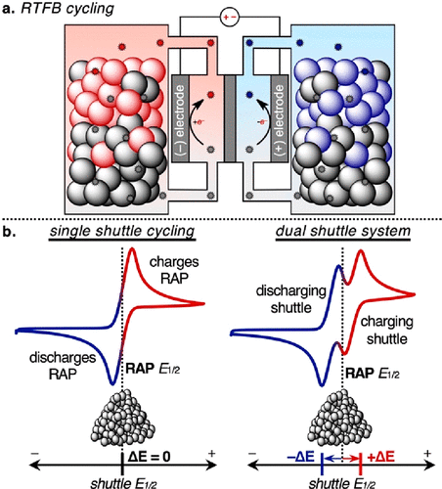
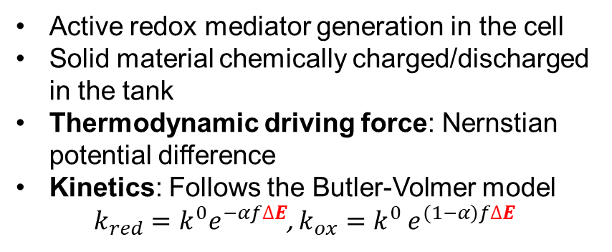
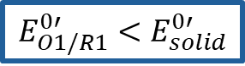
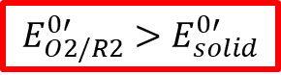
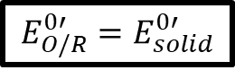
The Redox Targeting Process in RTFBs
The redox targeting process
Single mediator redox targeting
Dual mediator redox targeting
Cell
Tank
$$E_{O/R}^{0′}=E_{solid}^{0′}$$
$$E_{O1/R1}^{0′}<E_{solid}^{0′}$$
$$E_{O2/R2}^{0′}>E_{solid}^{0′}$$
Redox mediator
Solid material
Mediator 1
reduces
solid (S)
R₂
O₂
(Flow)
R
R
Charged (S⁺)
O
R
-e⁻
Mediator 2
oxidizes
solid (S⁺)
Electrode
R
O
Uncharged (S)
Mediator
reduces
solid (S)
Mediator
oxidizes
solid (S⁺)
O₁
R₁
O
O
(Flow)
Active redox mediator generation in the cell
Solid material chemically charged/discharged in the tank
Thermodynamic driving force: Nernstian potential difference
Kinetics: Follows the Butler-Volmer model
$k_{red}=k^{0}e^{−αf∆E}$, $k_{ox}=k^{0}$ $e^{(1−α)f∆E}$
Potential
Potential
Pros: Simple
Cons: Slow kinetics
Pros: Fast kinetics
Cons: Complex, low voltage efficiency
Sci. Adv. 2015, 1 (10), e1500886
ACS Energy Lett. 2022, 7 (10), 3337-3344
ACS Appl. Mater. Interfaces 2022, 14 (5), 6638–6648

Slide 4
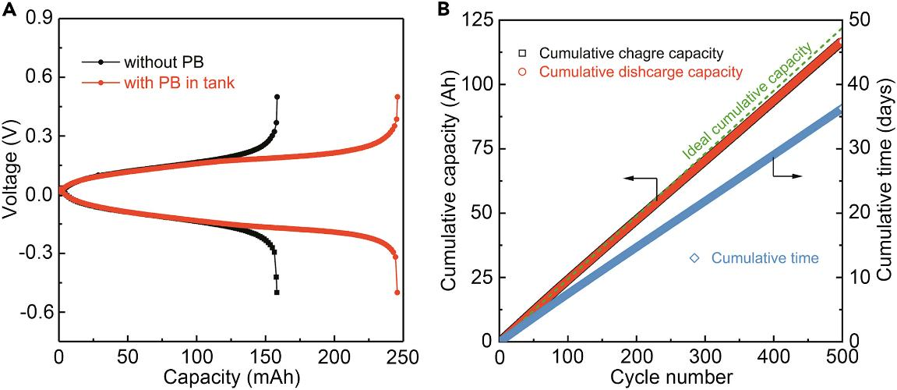
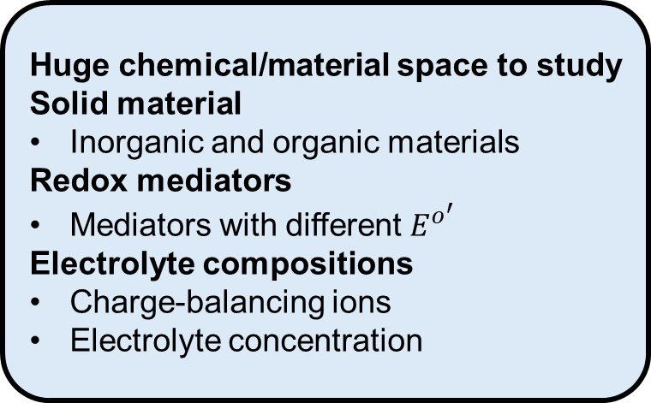
Challenges in Studying Redox Targeting
Battery cycling experiments
Huge chemical/material space to study
Solid material
Inorganic and organic materials
Redox mediators
Mediators with different $E^{o^{′}}$
Electrolyte compositions
Charge-balancing ions
Electrolyte concentration
Without solid
With solid
Figure of merits
Fast redox targeting kinetics
Large capacity for the solid material
Summary
Pros: Offers device-level metrics
Cons: Time-consuming, does not directly offer mechanistic insights about the redox targeting process
Is there a platform that provides more mechanistic insights?
Chemistry A European J 2022, 28 (25), e202200149
ACS Energy Lett. 2022, 7 (10), 3337–3344
Joule 2019, 3 (9), 2255–2267
Notes:
For redox targeting to work efficiently, it must be optimized. But doing that has its own challenges.

Slide 5
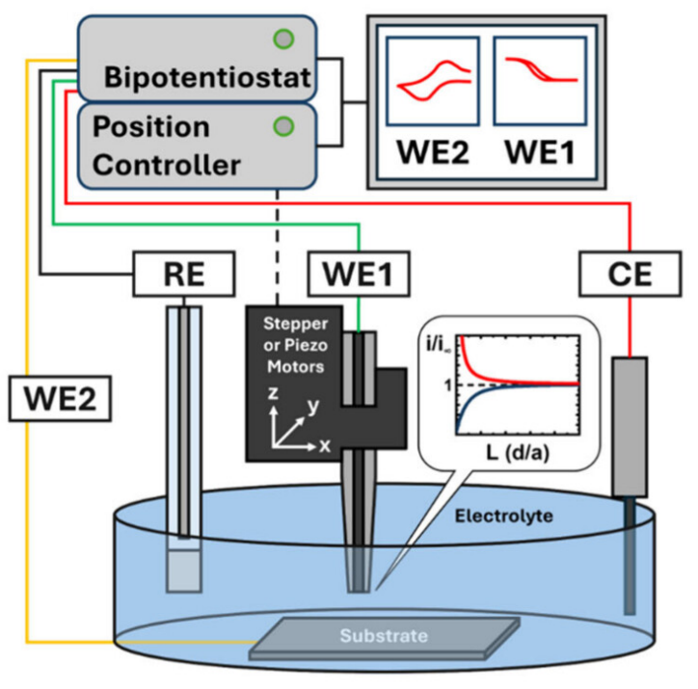
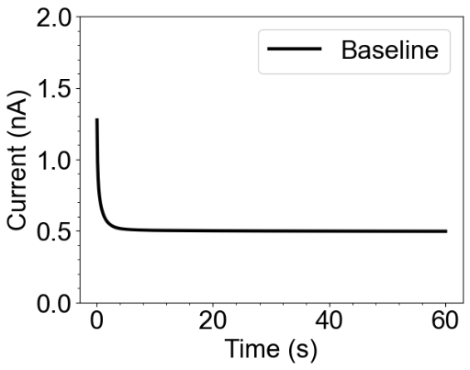
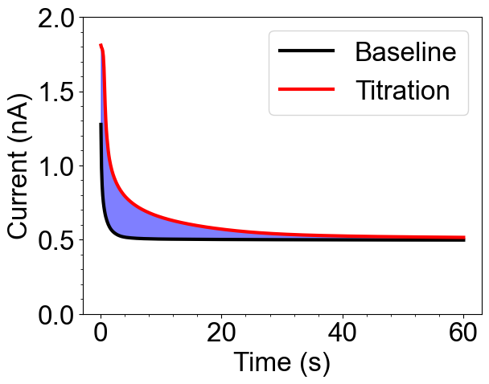
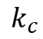
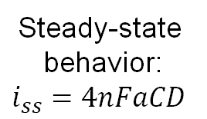
Redox-Titration with Scanning Electrochemical Microscopy (SECM)
Is there a platform that improves the throughput of studying mediated electron transfer processes in energy storage materials?
SECM schematics
(Tip: Ultramicroelectrode)
Current vs. time response
Steady-state
behavior:
$$i_{ss}=4nFaCD$$
R
O
R
O
R
O
Mass
Transfer
Mass
Transfer
R
$$k_{c}$$
O
O
X
(Substrate: material of interest)
Redox titration with SECM
Tip generates active species to titrate the charges in the substrate
A transient current increase can be observed
Can couple with simulations to understand the kinetics
Low throughput, not ideal for studying redox targeting due to the large chemical/material space to explore
Anal. Chem. 2025, 97 (15), 8147–8181
Chem. Rev. 2016, 116 (22), 13234-13278
J. Am. Chem. Soc. 2008, 130 (50), 16985–16995
Langmuir 2017, 33 (37), 9455–9463

Slide 6
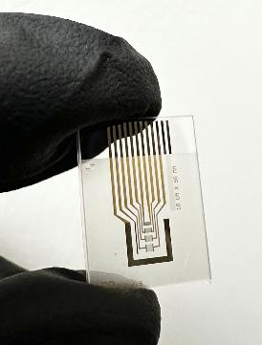
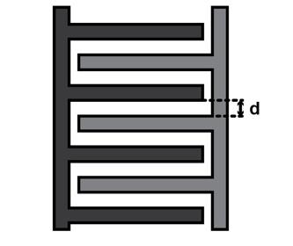
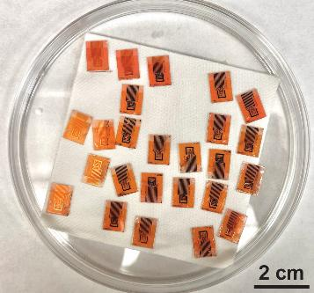
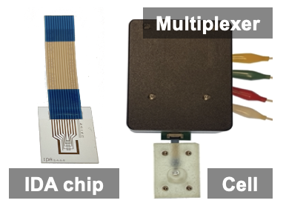
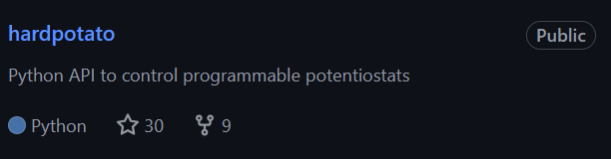
Interdigitated Electrode Arrays (IDAs)
25 bands per array
Gap
width
(in μm)
4 IDAs with different gap widths per chip
Two individually addressable working electrode arrays
Batched, high-yield microfabrication
Multiplexing circuit to control IDAs
Python library to control commercial electrochemical workstations
Summary
Automated electrochemical measurements can be performed on IDAs using Python
Large, combinatorial studies can be done
https://github.com/jrlLAB/hardpotato
ACS Meas. Sci. Au 2023, 3 (1), 62–72
Anal. Chem. 2023, 95 (11), 4840–4845
Device 2023, 1 (5), 100103–100103
Notes:
Emphasize myself did all the microfabrication and device packaging

Slide 7
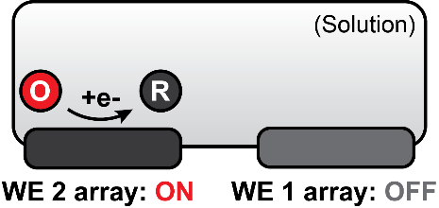
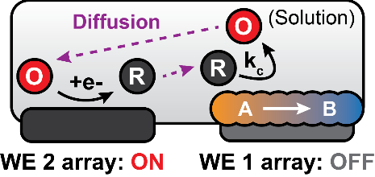
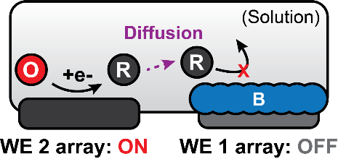
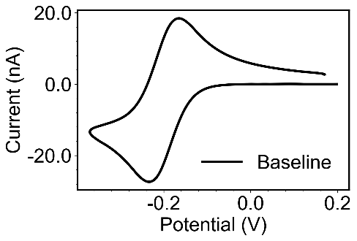
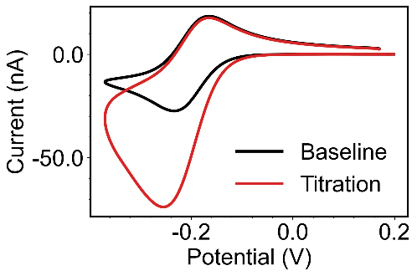
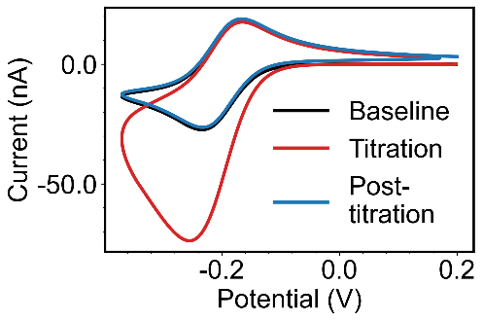
Redox-Titration with IDAs
Array 1
Array 2
Material of
interest
Performing a cyclic voltammetry (CV) with array 2 alone generates a normal “duck-shape” CV
Pattern the material of interest on array 1
A transient current increase will be observed on the redox titration CV
Current level returns to the baseline after the material has been fully titrated
Notes:
These data are simulated.

Slide 8
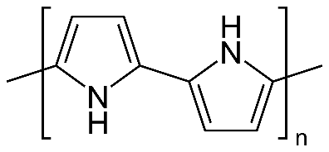
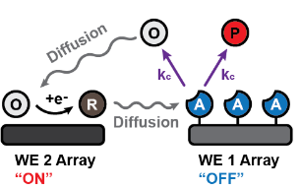
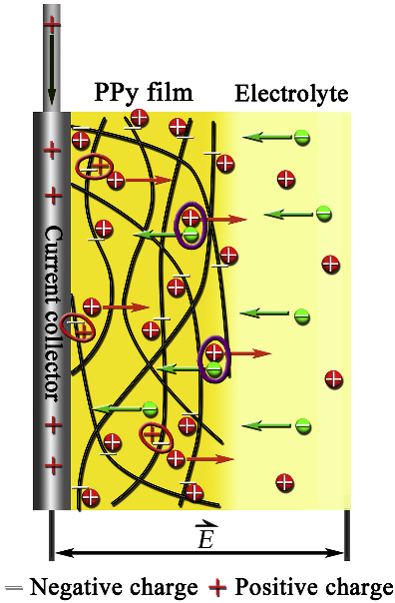
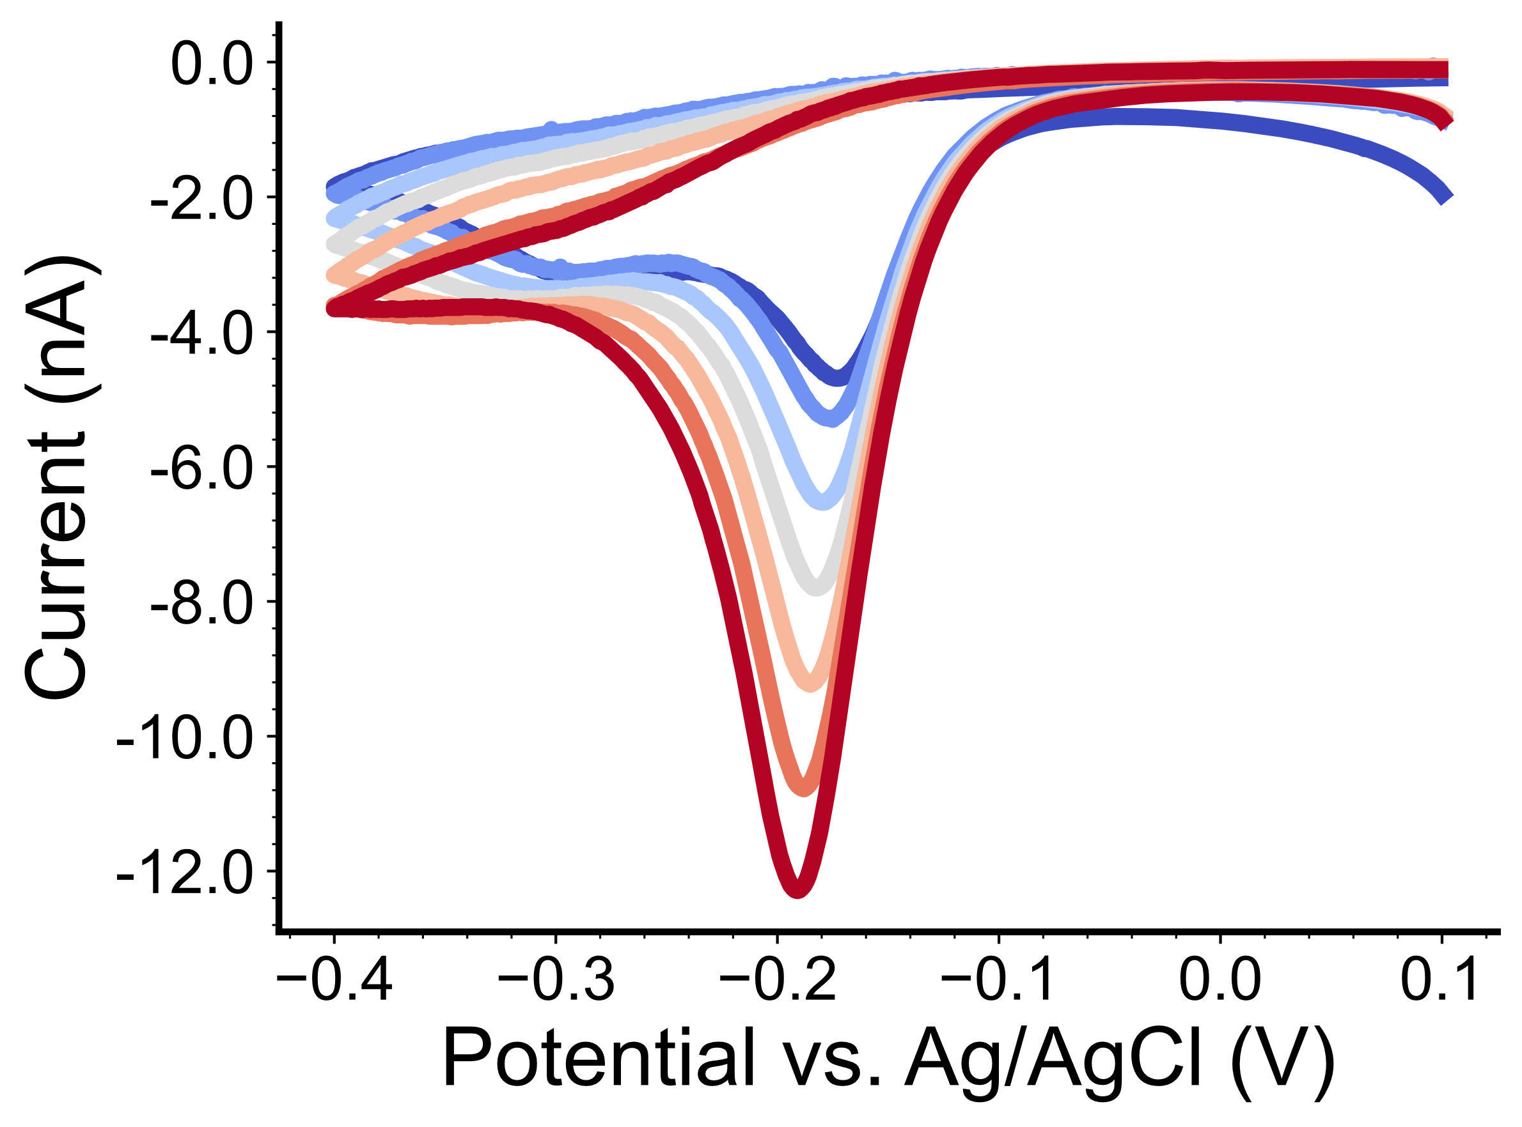
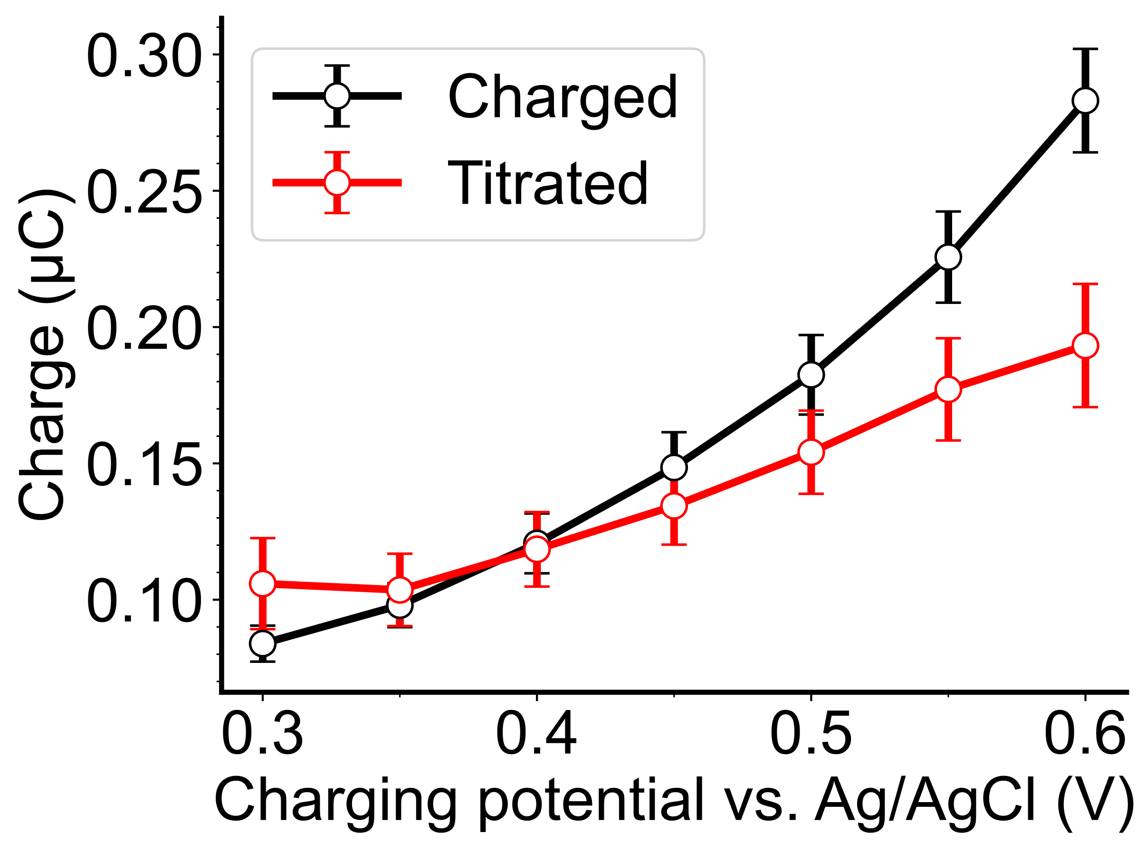
Redox Titration of Polypyrrole, a Model System
Polypyrrole (PPy) is a conjugated polymer
Candidate material for electrochemical supercapacitors and dual-ion batteries
Automated Redox Titration of Polypyrrole, a Conductive Polymer
Motivation
Polypyrrole can store anions from the electrolyte once oxidized
Use automated redox titration to study the charge storage behavior of PPy under different conditions
Wang, Z; Pence, M; Rodríguez-López, J. (Manuscript in preparation)
eScience 2021, 1 (2), 186–193
Phys. Chem. Chem. Phys. 2017, 19 (31), 21165–21173

Slide 9
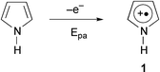
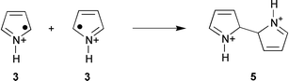
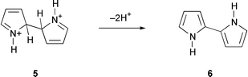
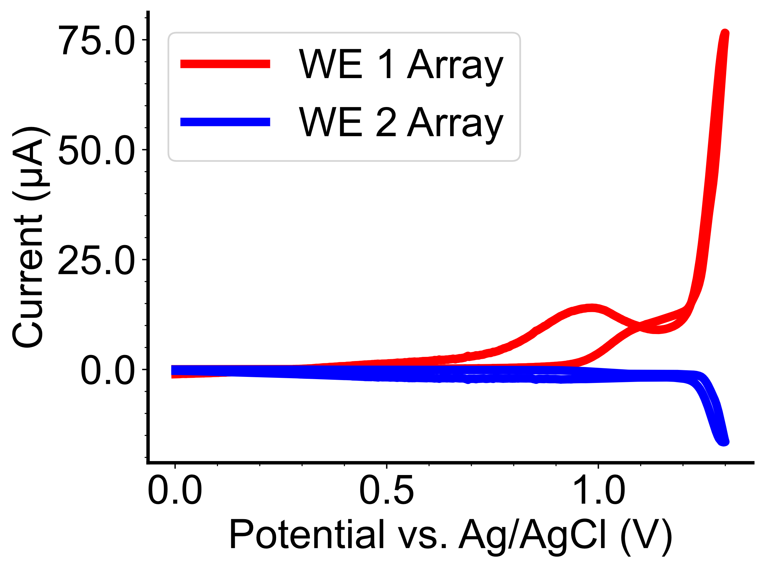
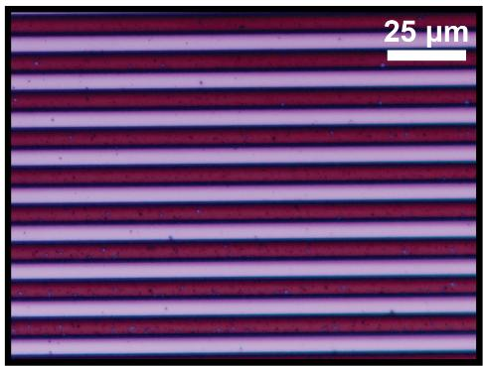
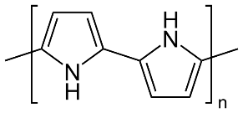
Electrodeposition of Polypyrrole (PPy) on IDAs
1. Monomer oxidation
PPy must be selectively patterned on one of the electrode arrays
Use dual-mode to limit the monomeric radicals on one of the arrays
Dual Mode:
Confine radicals on array 1
Radical concentration
High
2. Dimerization
Low
Array 2
ON: Reduction
Array 1
ON: Oxidation
3. Stabilization
Dual mode electrodeposition CV
Optical micrograph after deposition
Array 1
Array 2
Large oxidative
current
4. Additional combination-stabilizations
Small reducing current
Array 2 (Clean)
Array 1 (with PPy)
WE: Pt, RE: Ag/AgCl, CE: graphite. WE 2 potential: 0 V vs. Ag/AgCl.
10 mM pyrrole, 0.1 M TBAPF₆ in ACN; scan rate: 500 mV/s
Chem. Soc. Rev. 2000, 29 (5), 283–293

Slide 10
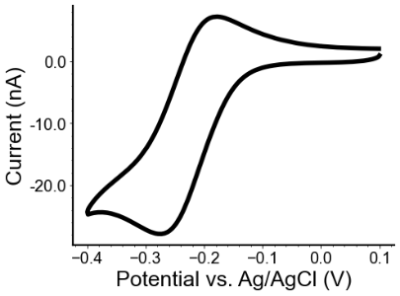
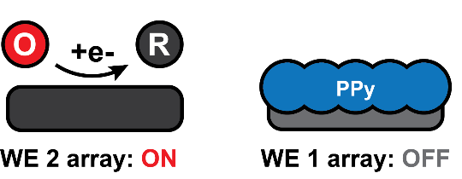
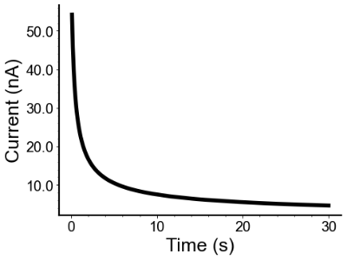
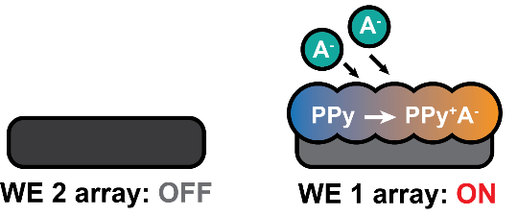
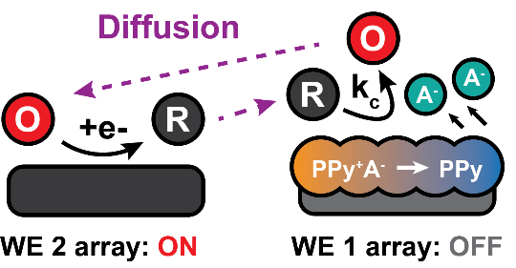
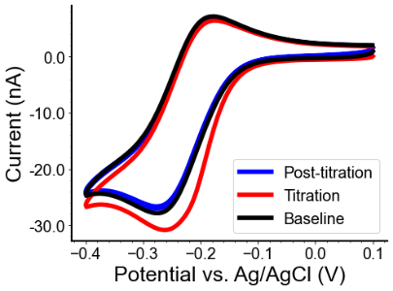
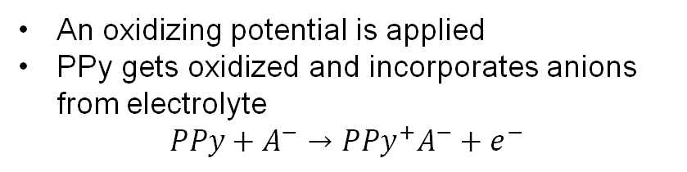
Experimental Workflow and Response
1. Baseline CV with array 2
WE: Pt, RE: Ag/AgCl, CE: graphite.
0.2 mM Ru(NH₃)₆³⁺, 0.1/0.5 M KCl, scan rate: 10/25/50 mV/s
A “duck-shape” baseline CV is obtained
2. PPy charging with array 1
An oxidizing potential is applied
PPy gets oxidized and incorporates anions from electrolyte
$$PPy+A^{−}→PPy^{+}A^{−}+e^{−}$$
3. Titration and post-titration CVs with array 2
Same CV as the baseline was conducted
A total of 3 cycles:
First cycle: Redox titration CV
Following cycles: Post-titration validation
Post-titration CV current returns to the baseline level
Notes:
Ruhex is more reductive than the charged form of Ppy

Slide 11
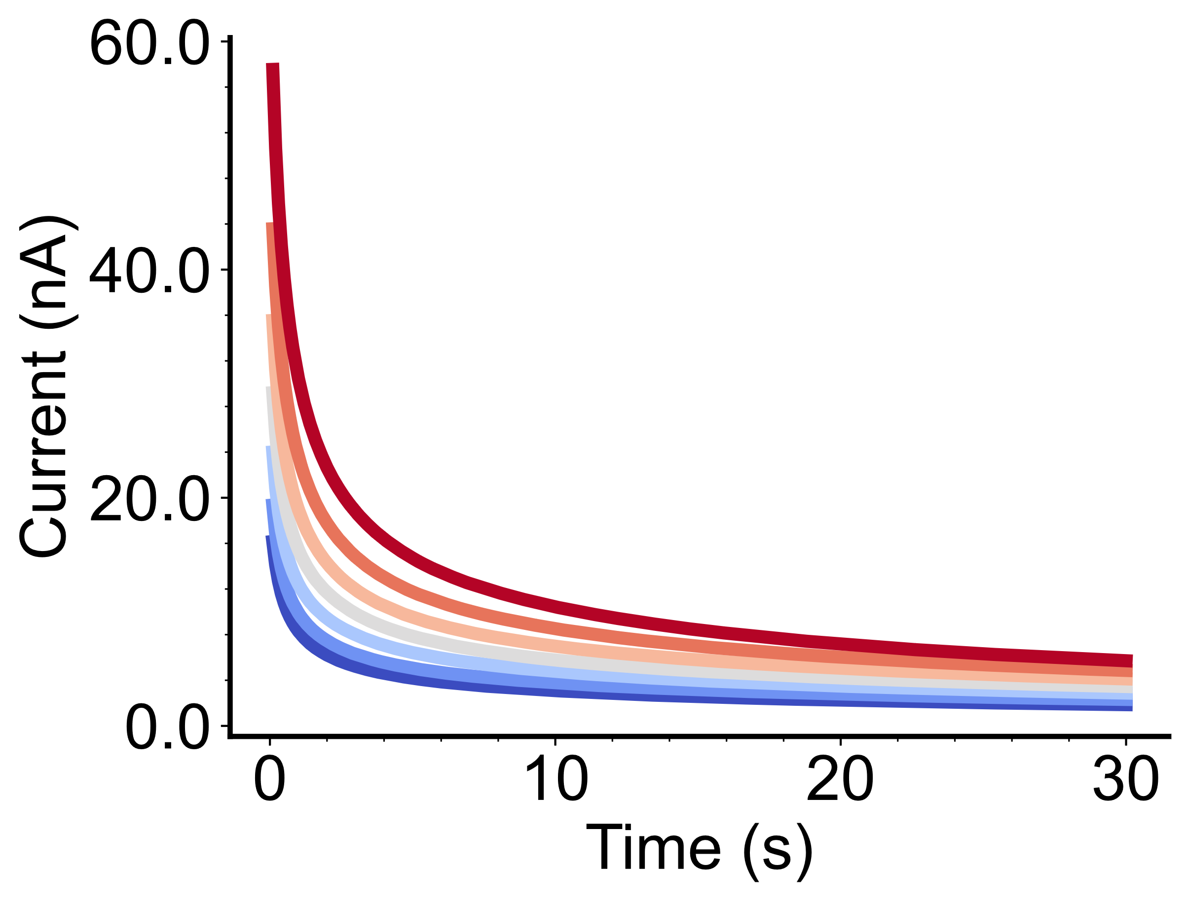
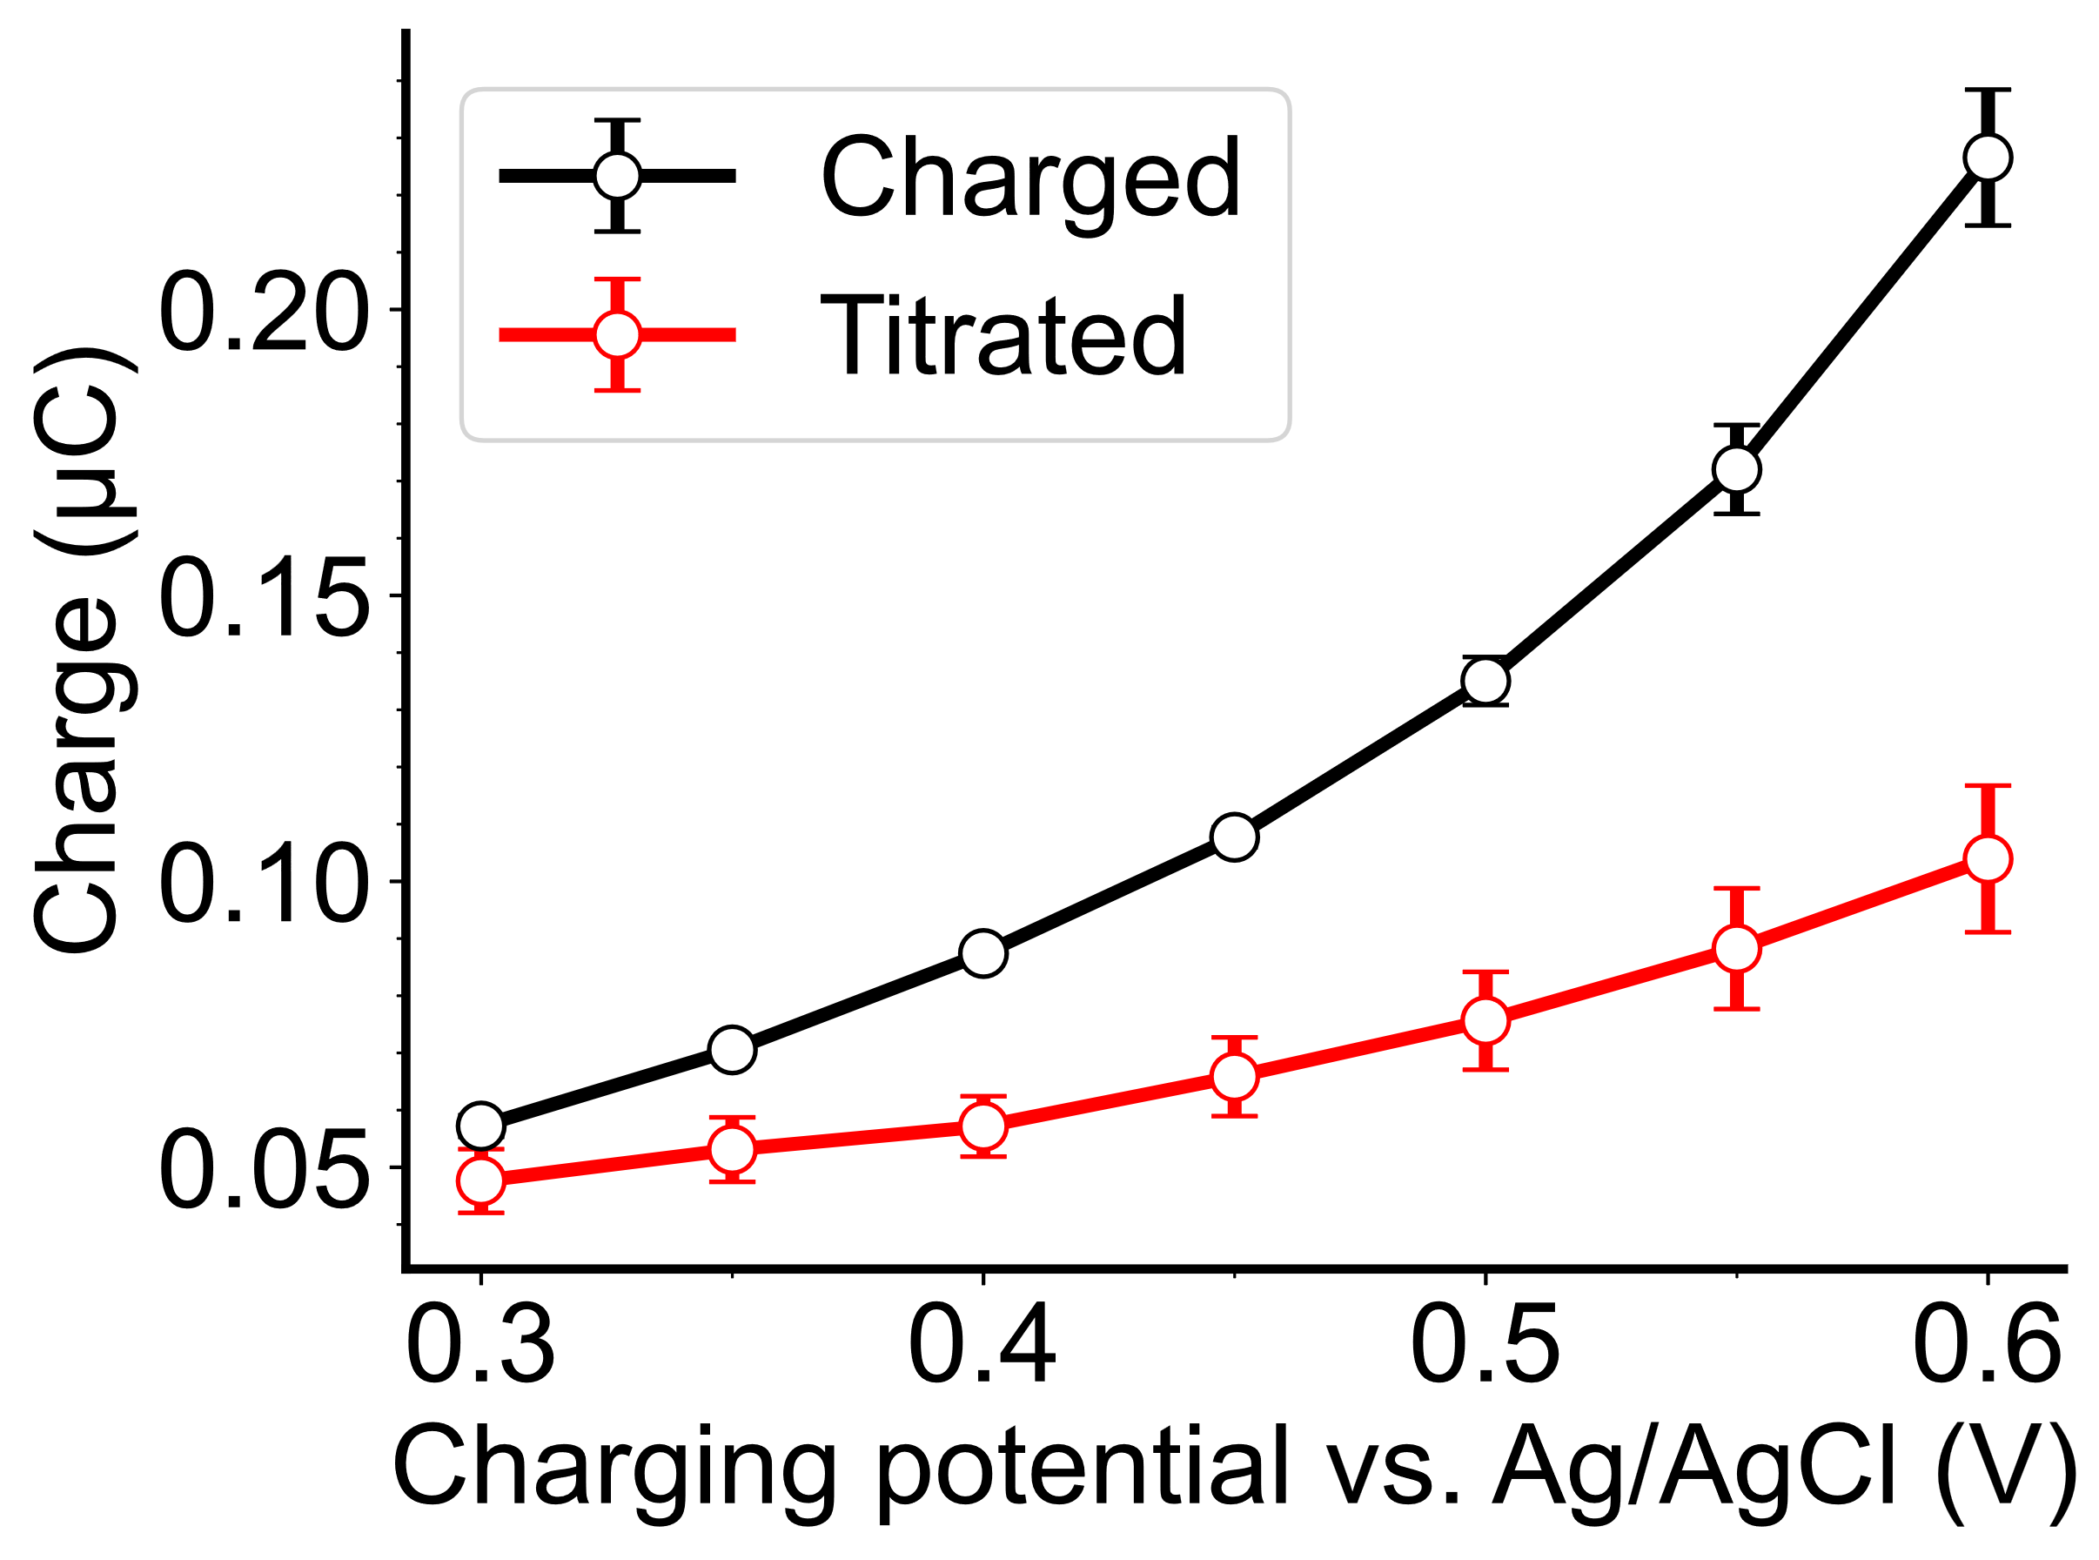
Behavior of PPy under Low Ionic Strength (0.1 M KCl)
PPy charging curves at different potentials
Baseline-subtracted titration CVs (10 mV/s scan rate)
* Data shown here were from the IDA with 2 μm gap width
Integrate to calculate the stored charge
Integrate to obtain the titrated charge
Finite-element simulations via COMSOL reveals the role of redox titration kinetics
Slow kinetics
Cannot establish full titration within the timescale of the CV measurement
Less titrated charge at a higher CV scan rate
Simulated behavior (10 mV/s)
Stored vs. titrated charge comparison
(10 mV/s)
(50 mV/s)
Notes:
“COMSOL” simulations

Slide 12
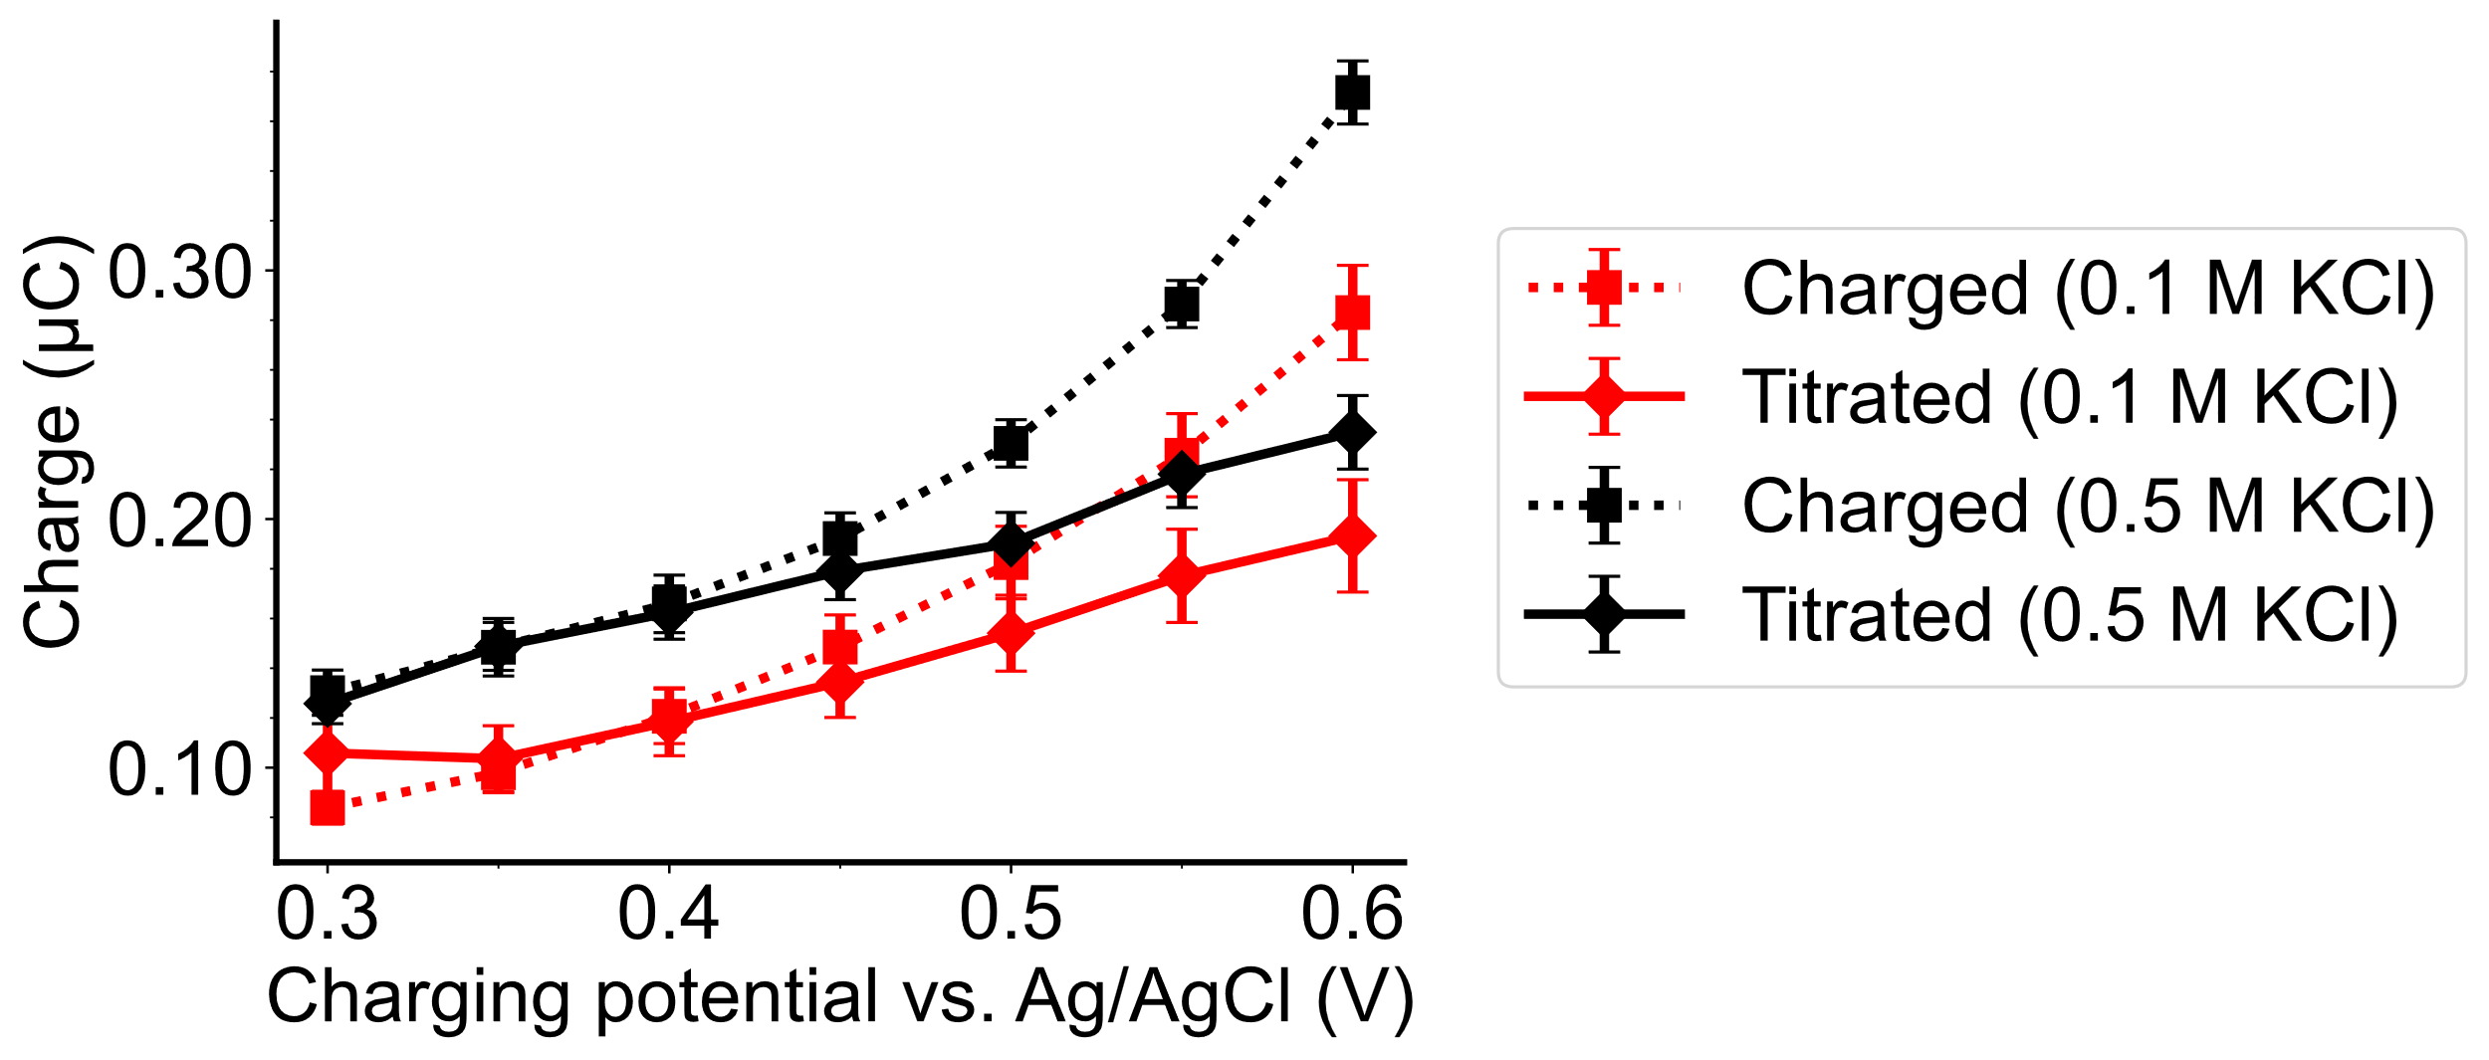
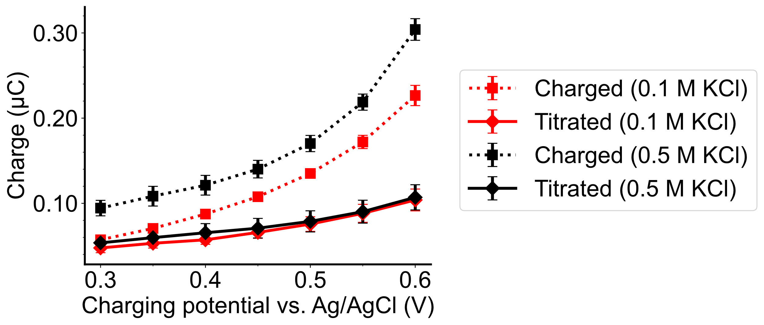
Redox Titration under Elevated Ionic Strength (0.5 M KCl)
Stored vs. titrated charge comparison
(10 mV/s)
(50 mV/s)
Elevated ionic strength (0.5 M KCl) leads to more charge storage in PPy
The influence of electrolyte concentration on the amount of titrated charge only shows up at low CV scan rate
Further confirms the slow redox-titration kinetics suggested by simulation
* Data shown here were from the IDA with 2 μm gap width, 10 mV/s scan rate

Slide 13
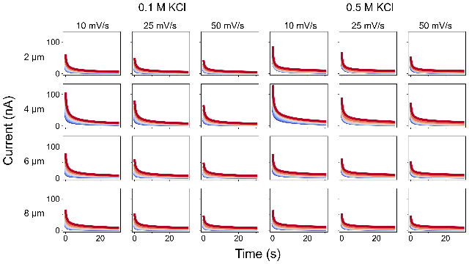
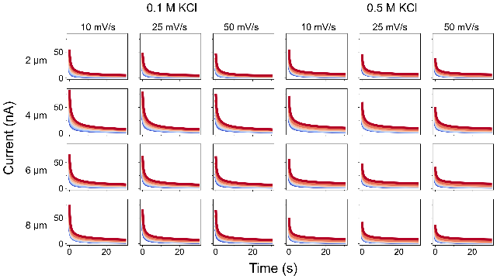
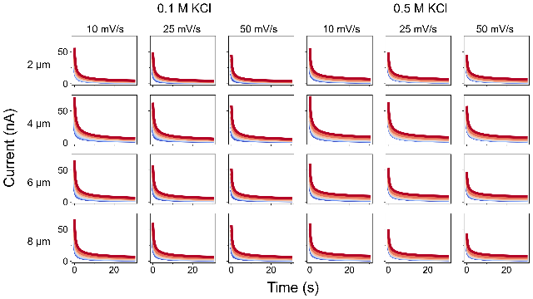



High-Throughput Nature of Our Platform
PPy charging potential (vs. Ag/AgCl)
0.30 0.35 0.40 0.45 0.50 0.55 0.60
500 automated redox titration within 50 hours (2016 CVs, 504 amperometries)
4 IDA gap widths, 7 polypyrrole charging potentials, 3 CV scan rates, and 2 ionic strengths

Slide 14

Conclusion
IDA is a useful platform to accelerate studies of mediated electron transfer processes for energy storage materials
Developed a workflow to perform automated redox-titration measurements with IDAs to study the charge storage behavior of polypyrrole
Applied COMSOL simulations understand the kinetics of the redox-titration process
Revealed the effect of ionic strength to the charge storage capacity of polypyrrole
Our workflow drastically improves the throughput of redox titration measurements
Wang, Z; Pence, M; Rodríguez-López, J. (Manuscript in preparation)
Notes:
Emphasize that I’m preparing a 1st author paper

Slide 15







Studying Prussian Blue with IDAs
Fe³⁺
Fe²⁺
C
N
Cation
Optical micrograph after PB deposition
Prussian Blue (PB)
Fe₄[Fe(CN)₆]₃
Prussian White (PW)
Fe₄[Fe(CN)₆]₃
Dual-mediator system
$$E_{M1}^{o^{′}}<E_{PB/PW}^{o^{′}}$$
$$E_{M2}^{o^{′}}<E_{PB/PW}^{o^{′}}$$
$$E_{PB/PW}^{o^{′}}$$
Bare Pt
(Array 2)
PB thin film
(Array 1)
Prussian Blue (PB) and its analogues are promising materials for RTFBs
Optimizing their performances requires screening different redox mediators and electrolyte compositions
Could the optimization process be accelerated with automated electrochemistry on IDAs?
Summary
PB can be electrodeposited on the IDAs
We began with a dual-mediator system to study the performance of PB

Slide 16




Automated Redox Targeting of Prussian Blue
“elab”: A solution handling robot
Electrochemistry
Inert gas flow
Solution handling
Automated redox targeting with different cations
Summary
Automated redox-targeting can be performed by coupling IDAs with solution handling hardware.
It is now possible to systematically screen a large chemical space: Redox mediators, electrolyte compositions, other Prussian Blue analogues, etc.

Slide 17







Acknowledgements
The JRL lab:
Prof. Joaquín Rodríguez-López
Dr. Michael Pence,
Dr. Oliver Rodríguez, Dr. Abhiroop Mishra
Gavin Hazen, Raghuram Gaddam, and Seth Putnam
All the 3rd years in the JRL lab
All the JRL lab members!
Collaborators:
Pacific Northwest National Laboratory
Dr. Eliot Woods and Dr. Ruozhu Feng
UIUC Cleanroom Research Engineers:
Joseph Maduzia, Dr. Ranveer Singh
Dr. Glennys Mensing
The JRL lab, Fall 2024
This work is funded by the Energy Storage Research Alliance "ESRA" (DE-AC02-06CH11357), an Energy Innovation Hub funded by the U.S. Department of Energy, Office of Science, Basic Energy Sciences.
L08-2765 – May 22nd (Thursday) 8:30 – 9:10 AM 512D, presented by Prof. Joaquín Rodríguez-López

Slide 18

Thank you! Questions?
Learn more about our research!
Contact:
ziruiw2@illinois.edu
joaquinr@illinois.edu

